Slide 1
Capital Facilities
Planning Workshop
Developing a proactive plan to address current and coming enrollment
May 14, 2018

Slide 2
Woodland Public Schools Capacity
Elementary Schools
School Building | Building SF | Teaching Stations | Capacity CFP ‘15 | 10/1/17 Headcount
Woodland Primary School (K-1) | 59,296 | 19 | 399 | 328
Woodland Intermediate School (2-4) | 54,718 | 21 | 441 | 495
Yale Elementary School (K-4) | 8,703 | 3 | 63 | 40
Total Elementary Capacity |  | 43 | 903 | 863
Middle School
Woodland Middle School (5-8) | 86,271 | 38 | 790 | 729
High School
Woodland High School (9-12) | 152,830 | 40 | 866 | 730 (664 w/o RS)
Alternative Schools
Lewis River Academy (K-8) | 2,417 | 2 | 48 | 56
TEAM High School (9-12) | 1,700 | 2 | 60 | 87

Slide 3
Projected Enrollment Growth
—Arithmetic Models
2017-2018 OSPI Cohort Survival | 2015 Actual | 2016 Actual | 2017 Actual | 2018 Projected | 2019 Projected | 2020 Projected | 2021 Projected | 2022 Projected | 2023 Projected
K-4 | 832 | 862 | 876 | 897 | 933 | 925 | 930 | 937 | 946
5-8 | 715 | 721 | 756 | 764 | 737 | 792 | 799 | 821 | 860
9-12 | 728 | 720 | 754 | 783 | 792 | 799 | 824 | 839 | 805
 | 2,275 | 2,303 | 2,386 | 2,444 | 2,462 | 2,516 | 2,553 | 2,597 | 2,611
2015 CFP Projections | 2015 Actual | 2016 Projected | 2017 Projected | 2018 Projected | 2019 Projected | 2020 Projected | 2021 Projected
K-4 | 833 | 866 | 871 | 894 | 936 | 939 | 957
5-8 | 720 | 710 | 736 | 744 | 722 | 773 | 774
9-12 | 742 | 728 | 725 | 744 | 772 | 766 | 795
 | 2,295 | 2,304 | 2,332 | 2,382 | 2,430 | 2,478 | 2,526

Slide 4
K-12 Enrollment Projections: Arithmetic Models

Slide 5
9-12 Enrollment Projections: Arithmetic Models

Slide 6
5-8 Enrollment: Arithmetic Models
WMS Capacity

Slide 7
K-4 Enrollment Projections: Arithmetic Models

Slide 8
Expected Growth: Demographics vs History
Historical Growth rate about 1.5-2% growth year over year
  Arithmetic Models fairly good at predicting future enrollment
Anticipated Housing Increases
  About 1000 homes over the next 8-10 years
    Two developments near S. Pekin and Whalen Roads (By Walt’s Meats)
    One development near WHS off of Dike Access
IF these developments materialize we anticipate a significant increase in student enrollment at a rate that surpasses the arithmetic models.

Slide 9
How many students per home?
2015 CFP Student Generation Rates
 | Elementary | Middle School | High School
Single Family | 0.229 | 0.048 | 0.086
Multi Family | 0.289 | 0.105 | 0.105
In simple terms….
Each Single Family home resulted in .229 Elementary Student, .048 Middle School Student, and .086 High School Student enrolling in Woodland Schools.
Each Multi-Family home (apartment) resulted in .289 Elementary Student, .105 Middle School Student, and .105 High School student enrolling in Woodland Schools

Slide 10
Student Generation Rates: Are they accurate?
Current Student Generation Rates were largely based on property sales that occurred during and immediately following the deepest part of the Great Recession.
  Based on very few home sales. Statistically volatile number
  Corresponded with flattening and decrease of student enrollment
In order to make estimates based on more recent data we have hired a demographer to update the Student Generation Rates

Slide 11
Impact of Growth: Single Family Homes
# of Homes | Elementary | Middle School | High School | Total
100 | 22.9 | 4.8 | 8.6 | 36.3
200 | 45.8 | 9.6 | 17.2 | 72.6
300 | 68.7 | 14.4 | 25.8 | 108.9
400 | 91.6 | 19.2 | 34.4 | 145.2
500 | 114.5 | 24.0 | 43.0 | 181.5
600 | 137.4 | 28.8 | 51.6 | 217.8
700 | 160.3 | 33.6 | 60.2 | 254.1
800 | 183.2 | 38.4 | 68.8 | 290.4
900 | 206.1 | 43.2 | 77.4 | 326.7
1000 | 229.0 | 48.0 | 86.0 | 363.0

Slide 12
Impact of Growth: Multi-Family Homes
# of Multi Family Homes | Elementary | Middle School | High School | Total
100 | 28.9 | 10.5 | 10.5 | 49.9
200 | 57.8 | 21.0 | 21.0 | 99.8
300 | 86.7 | 31.5 | 31.5 | 149.7
400 | 115.6 | 42.0 | 42.0 | 199.6
500 | 144.5 | 52.5 | 52.5 | 249.5
600 | 173.4 | 63.0 | 63.0 | 299.4
700 | 202.3 | 73.5 | 73.5 | 349.3
800 | 231.2 | 84.0 | 84.0 | 399.2
900 | 260.1 | 94.5 | 94.5 | 449.1
1000 | 289.0 | 105.0 | 105.0 | 499.0

Slide 13
Option A: Grow Our Current Schools
Incrementally Grow Schools as population arrives
  Portable Classrooms
  Expansions to current facilities
Land and opportunity for additional classrooms
  WPS add 10-12 classrooms (additional 200-240 students, 600+ students)
  WIS add 8-12 classrooms (additional 160-240 students, 600+ students)
  WMS add 8-12 classrooms (additional 200-300 students, 100+ students)

Slide 14
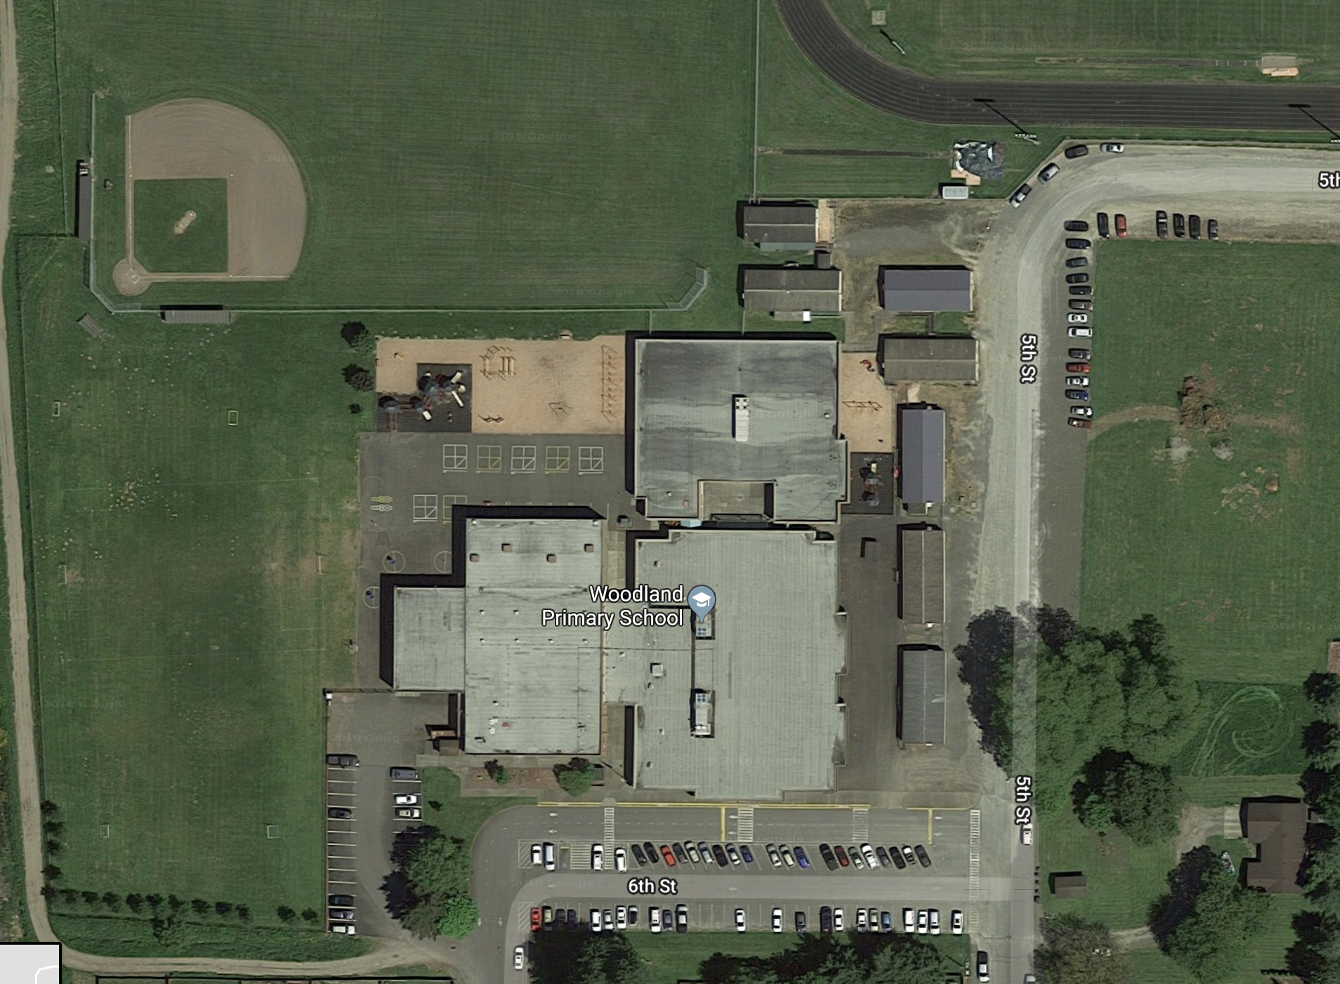

Slide 15
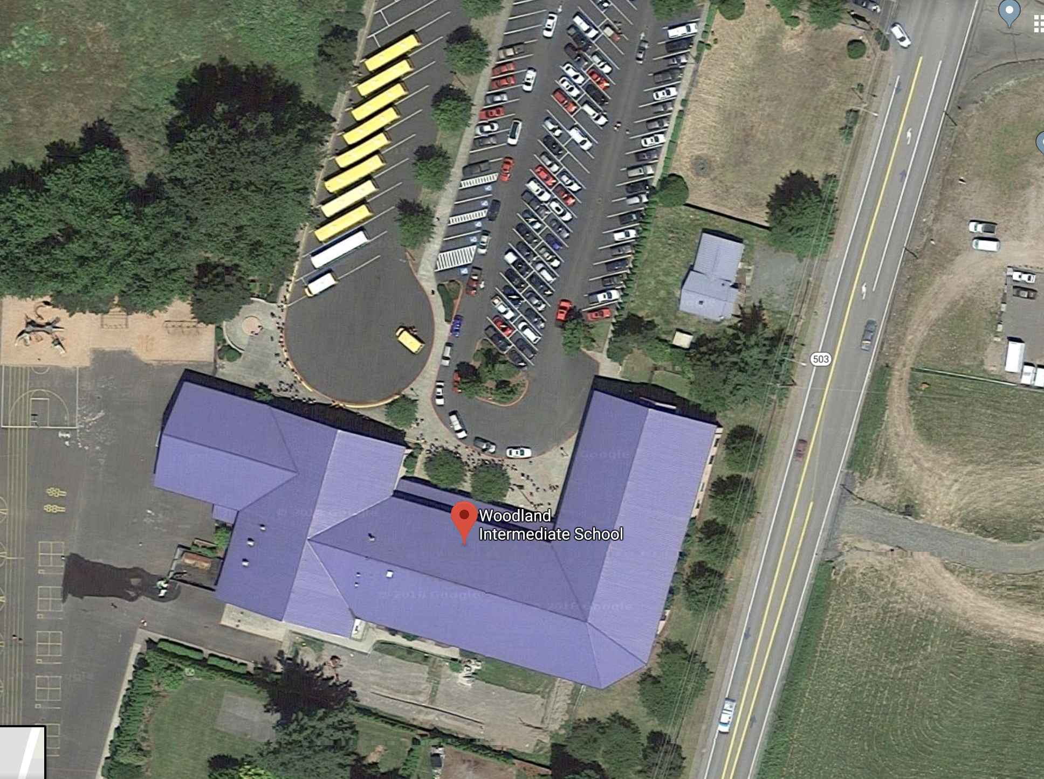

Slide 16
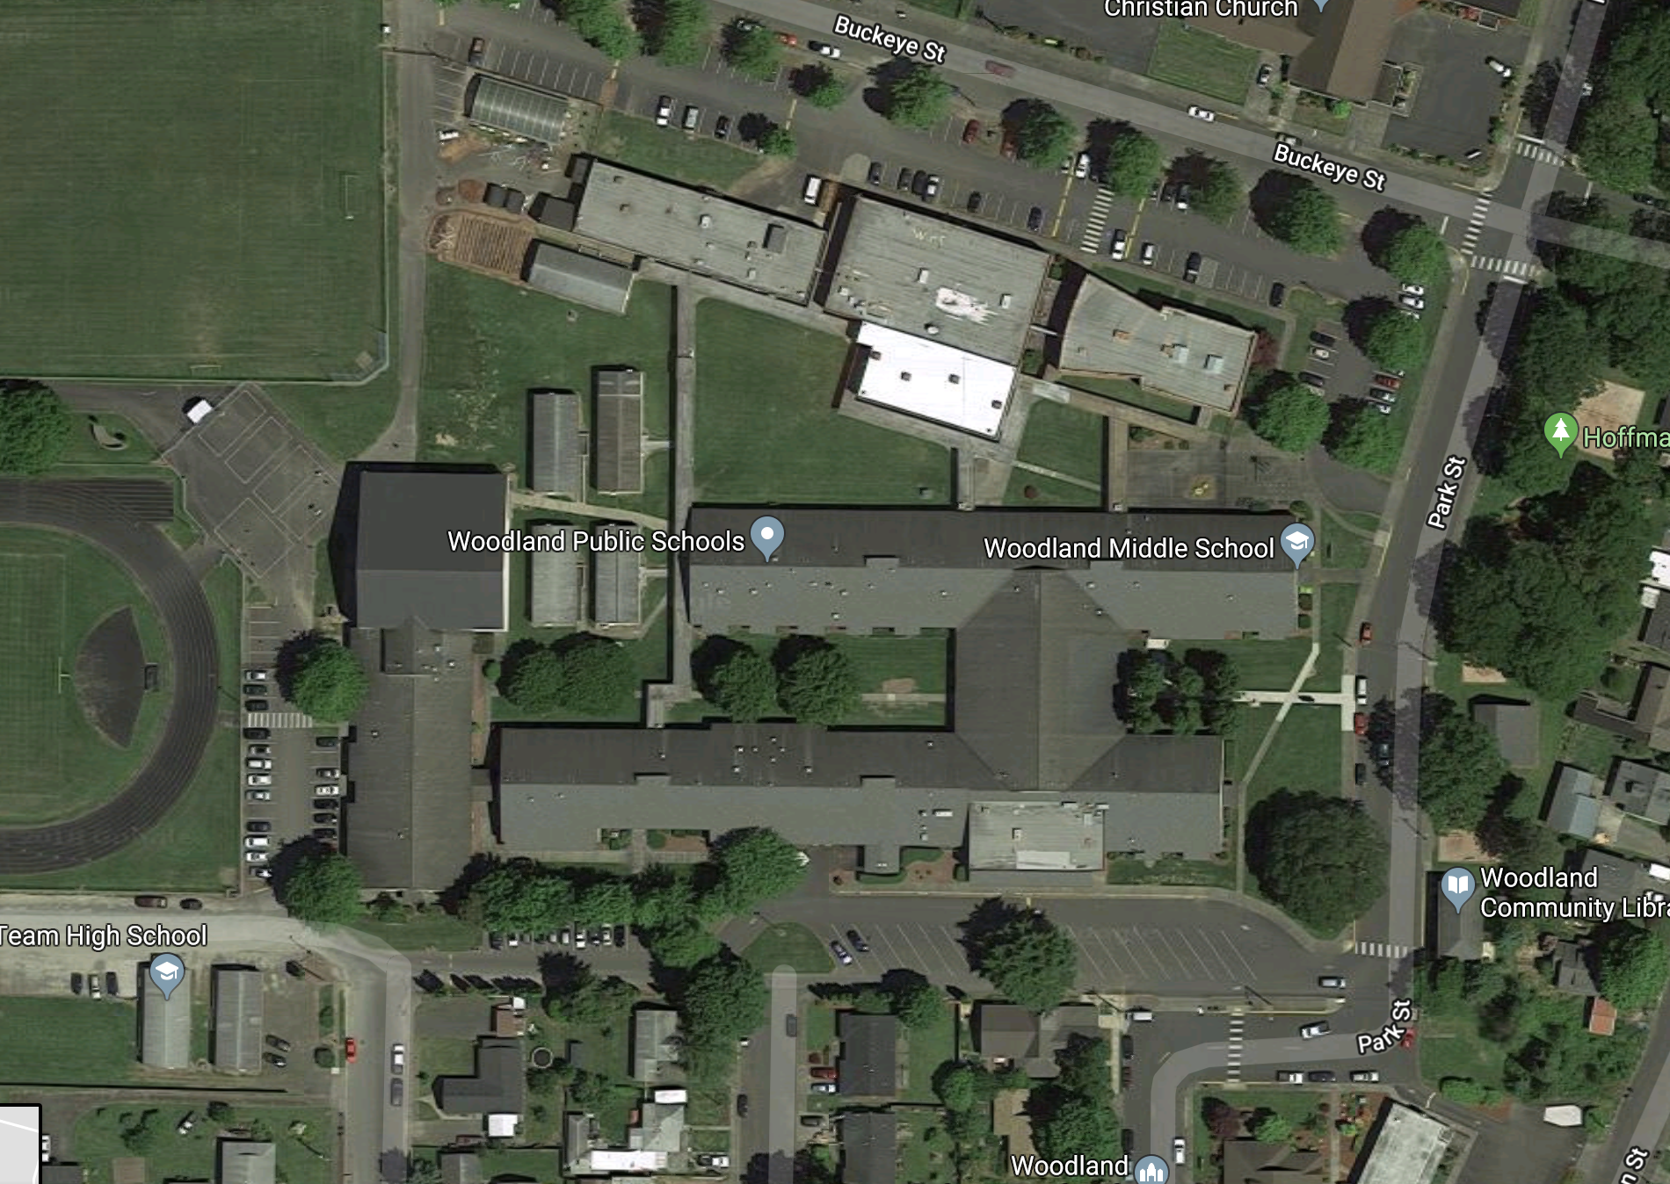

Slide 17
Option B: Add a new Elementary School
21 classroom Elementary School
  Increase elementary capacity by about 441 students
  WPS Estimated Capacity approximately 399
  WIS Estimated Capacity approximately 441
  Yale Estimated Capacity approximately 63
  New Elementary Estimated Capacity Approximately 441
  Total Elementary Capacity = 1334 students
Transition Grade 5 students from WMS to Elementary Schools

Slide 18
School Size Research
Review of Empirical Evidence about School Size Effects: A Policy Perspective (Leithwood, K; Jantzi D)
Review examined 57 post 1990 empirical studies of school size effects on a variety of student and organizational outcomes
The weight of evidence provided by this research clearly favors smaller schools.
Students who traditionally struggle at school and students from disadvantaged social and economic backgrounds are the major benefactors of smaller schools.

Slide 19
School Size Research
Review of Empirical Evidence about School Size Effects: A Policy Perspective (Leithwood, K; Jantzi D)
Elementary schools with large proportions of such students should be limited in size to not more than about 300 students;
Elementary schools serving economically and socially heterogeneous or relatively advantaged students should be limited in size to about 500 students.
Secondary schools serving exclusively or largely diverse and/or disadvantaged students should be limited in size to about 600 students or fewer
Secondary schools serving economically and socially heterogeneous or relatively advantaged students should be limited in size to about 1,000 students.

Slide 20
School Size Research
School Size Effects: Review and Conceptual Analysis (Scheerens, J. et.al.)
a review of international review studies on school size effects
…”there appears to be a fair degree of consensus on optimal school size ranges for primary and secondary school.”
“The estimates by Leithwood and Jantzi (2009) express this consensus well when they claim that optimal school sizes at elementary and secondary school levels are 500 and 1,000, respectively.”

Slide 21
Funding Options
 | Capital Levy | Capital Bond
Uses | Technology Maintenance (Roofs, Boilers, etc.) New Facilities | Long Life Facilities
Difference in Mechanism | Authorization to levy an aggregate amount of taxes each year for a span of up to six years | Authorization to sell bonds and levy taxes to pay bond over long-term (up to 30 years)
What it takes to pass | 50% + 1 vote | 60%

Slide 22
Other Significant Needs
HVAC upgrade at WIS
  Add AC, replace inefficient VAV System
    $800,000 to $1,000,000
Capital Maintenance Levy
  Decreased funding for M&O with new ”Enrichment” Levy
Technology Levy
  Decreased funding for new equipment acquisition with new ”Enrichment” Levy

